Slide 1
Sumo Team A
Team 8
Robotics Competition
Hunter Lane, Graham Rose, Sean Sussman, Jordan Ziegler
March 6, 2017

Slide 2
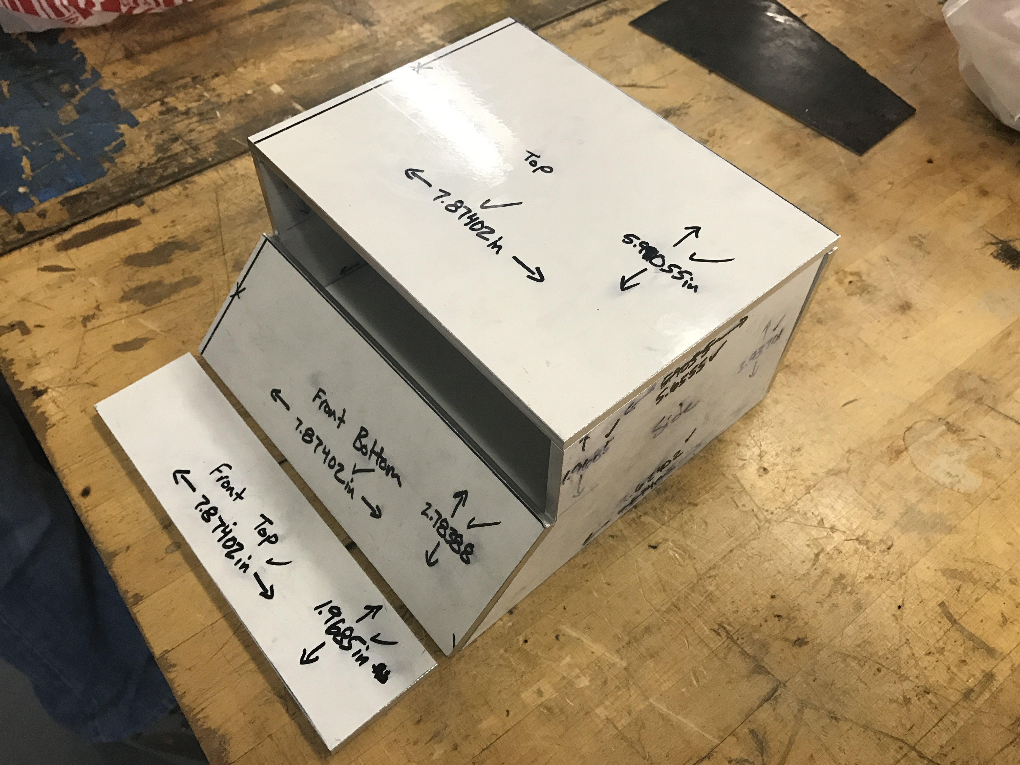
Project Description
Mega Sumo – Autonomous
  3kg, 20cm x 20cm, fully autonomous [1]
Mega Sumo – Remote Controlled
  3kg, 20cm x 20cm, RC compatible [1]
A single Sumo robot will be capable of RC
and autonomous control
Combat Bot Modular Shell
  Add-on to mega sumo
  Qualified for 10lb combat competitions
Figure 1: Current Manufactured Design
Sumo A, Team 8, 3/6/17, Speaker: Jordan Ziegler – Slide 2

Slide 3
Updates
Recent accomplishments since last presentation
  Electronics fully functioning
  Algorithm is being converted from if-statements to while-loops
  Sumo shell, base, and intermediate shafts constructed
No changes have been made to the frame design
Combat shell changed to Spearbot-inspired design to significantly
increase development
Remaining manufacturing steps include:
  combat shell construction
  Finish internal skeleton and relief cuts for sumo shell
Sumo A, Team 8, 3/6/17, Speaker: Graham Rose – Slide 3

Slide 4
Updates: Design of Experiments
Table 1: Design of Experiments Data
Sumo A, Team 8, 3/6/17, Speaker: Graham Rose/Hunter Lane – Slide 4

Slide 5
Updates: Design of Experiments Cont.
Figure 2: Distance From Surface Response Diagram
Sumo A, Team 8, 3/6/17, Speaker: Hunter Lane – Slide 5

Slide 6
Moving Forward: Plans of Manufacturing and Testing
Frame and shell manufacturing will be completed by Hardware Review 2
Testing will be broken down into two steps:
  Edge sensor algorithm completion and testing
  Opponent sensor implementation
Contingencies:
  Team has $468.98 allocated to potential redesigns and complications
  Motors can be slowed down to increase maneuverability and simplify coding
Sumo A, Team 8, 3/6/17, Speaker: Sean Sussman – Slide 6

Slide 7
Moving Forward: Manufacturing and Testing Schedule
Figure 3: Manufacturing and Testing Schedule
Sumo A, Team 8, 3/6/17, Speaker: Sean Sussman – Slide 7

Slide 8
Schedule & Budget: Gantt Chart
Figure 4: Fall Semester Gantt Chart
Sumo A, Team 8, 3/6/17, Speaker: Hunter Lane – Slide 8

Slide 9
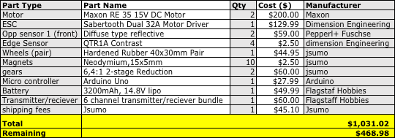
Schedule & Budget: Bill of Materials
Costs to Date: $1,031.02
Remaining Budget: $468.98
Table 2: Bill of Materials [2-9]
Sumo A, Team 8, 3/6/17, Speaker: Hunter Lane – Slide 9

Slide 10
References
[1] “Unified Sumo Robot Rules”, Robotgames.net. 2016, Web. 25 Sept 2016.
[2] adafruit.com, 2005. [Online]. Available: https://www.adafruit.com. [Accessed: 30 Sep 2016].
[3] Amazon.com, 5 Jul 1994. [Online]. Available: https://www.amazon.com. [Accessed: 30 Sep 2016].
[4] Massachusetts Institute of Technology, “Sumo Robots,” MITMECHE. Dec 2014.
[5] Colson Casters 2016. [Online] Availabe: http://www.colsoncaster.com/wheel/performa/ [Accessed 22 Nov 2016].
[6] "Small dc motors and drive systems | maxon motor", Maxonmotorusa.com, 2016. [Online]. Available: http://www.maxonmotorusa.com/maxon/view/content/index. [Accessed: 23- Nov- 2016].
[7] Motor, "GM15 25:1 6mm Planetary Gear Pager Motor :: Solarbotics", Solarbotics.com, 2016. [Online]. Available: https://solarbotics.com/product/gm15/. [Accessed: 23- Nov- 2016].
[8] F. Dede, "How to Make a Sumo Robot", Jsumo.com, 2016. [Online]. Available: https://jsumo.com/how-to-make-sumo-robot/. [Accessed: 23- Nov- 2016].
[9] "Robot Parts & Electronics - Build a Robot with The Robot MarketPlace", Robotmarketplace.com, 2016. [Online]. Available: http://www.robotmarketplace.com/store.html. [Accessed: 23- Nov- 2016].

Slide 11



Sponsors

Slide 12
Conclusion
Questions or comments?

